Slide 1
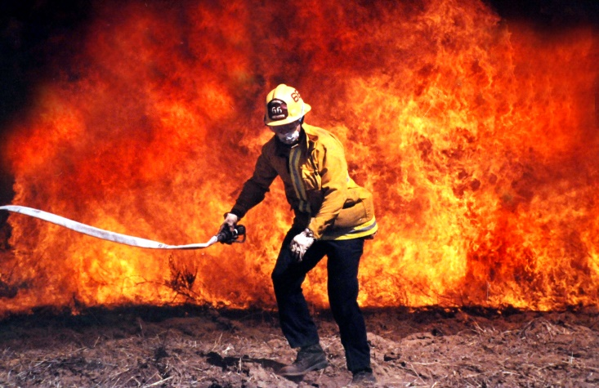
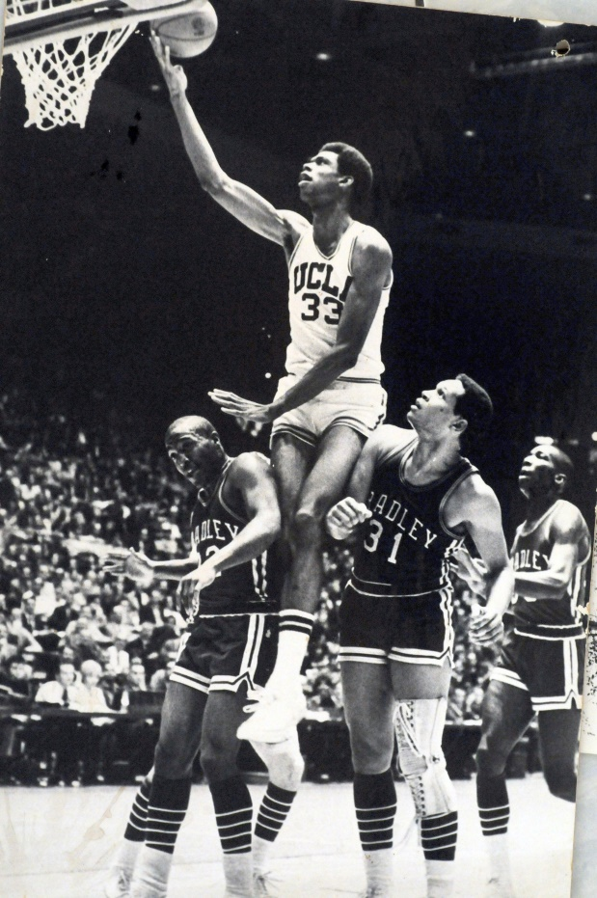
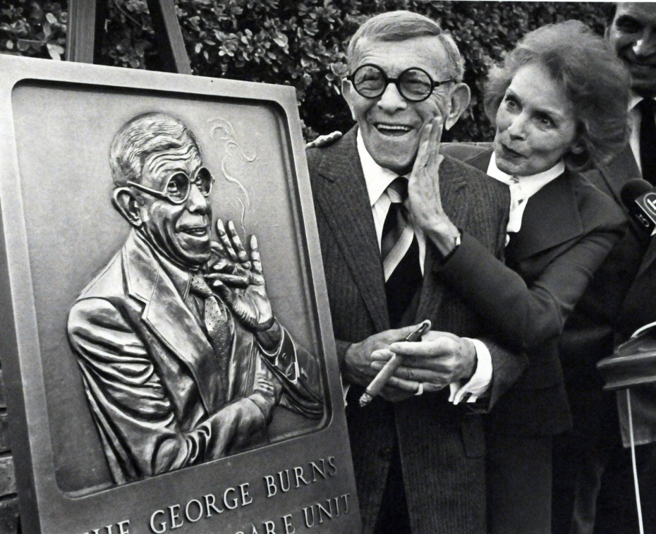
The Sun City Photo Club Presents
Joel Lugavere – an award winning photographer for the LA Times, will show some of his photos and give tips about safely capturing events that you may see.
Thursday February 10th
6:30 PM at Desert Vista
and via
Zoom.
For Details
Call:
(702) 255-5545
Or Google:
Sun City Summerlin Photo Club

